Slide 1
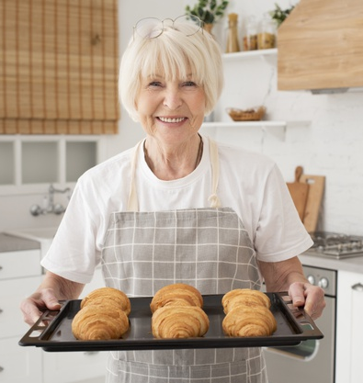
The idea is...
The idea is to create a platform for selling products from local culinary experts.
Why are we developing it?
Because my grandmother had complained that her food often spoils because she lives alone and it's expensive to cook for one serving.

Slide 2
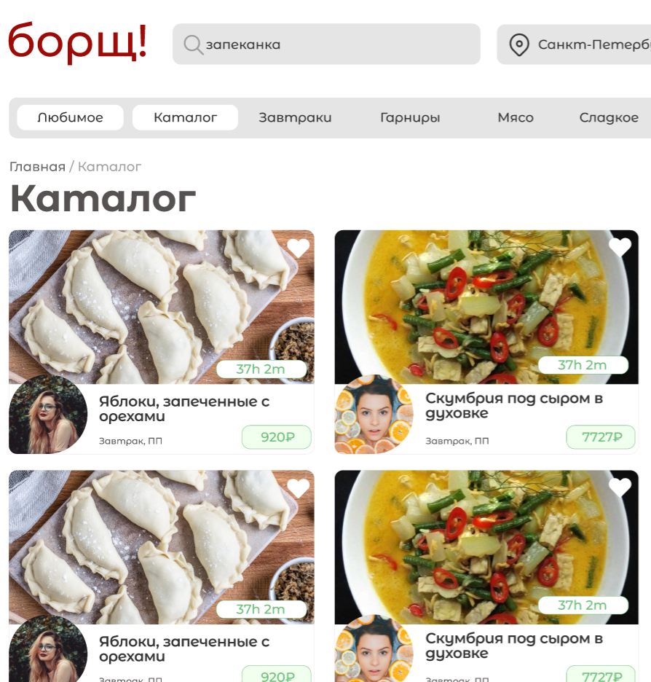
Little bit about Borscht
Our solution offers a catalog with products, and a system for creating your own products.
At the moment we have implemented:
UX-design;
system’s logic.
The "Borscht!" will help my grandmother and a hundred other grandmothers find their place and set up their own shop front.
Design by Loginova Sofia

